Slide 1
SYMPTOMS, SIGNS AND INVESTIGATIONS IN NEUROLOGY
DR PAUL OLOWOYO

Slide 2
NEUROLOGICAL DIAGNOSTIC PROCESS
There are three components to the neurological diagnostic process.
In descending order of importance these are:
History
Examination
Investigation

Slide 3
History taking
Listen to your patient, he is telling you the diagnosis.
Sir William Osler 1849-1919.
We have two ears and one mouth so that we can listen twice as much as we speak. Epictetus 55-135 AD.

Slide 4
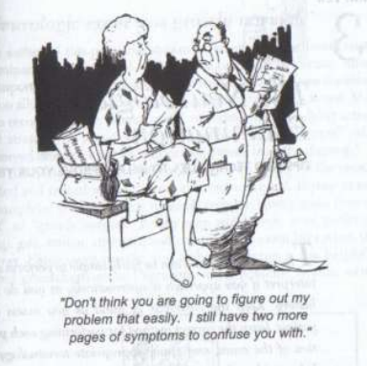
Some patients are poor historians!

Slide 5
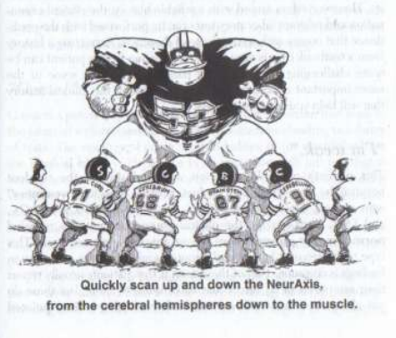
History taking and examination
Where is the lesion?
What is the lesion?

Slide 6
The neural axis
Meninges
Cerebral cortex
Subcortical
Basal nuclei
Diencephalon (Thalamus)
Brainstem
Spinal cord
Roots
Spinal nerves
Neuromuscular junction
Muscles

Slide 7
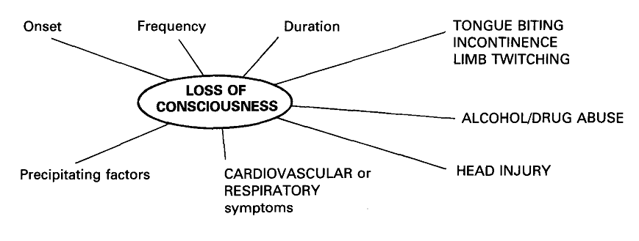
Loss of consciousness

Slide 8
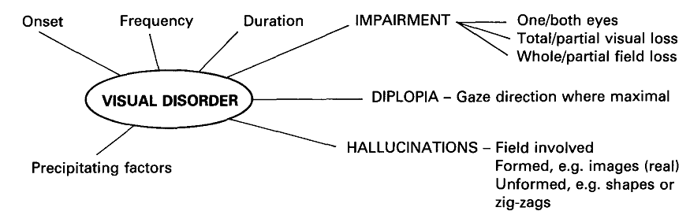
Visual disorder

Slide 9
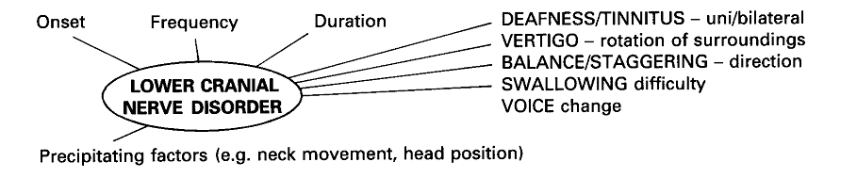
Lower cranial nerves

Slide 10
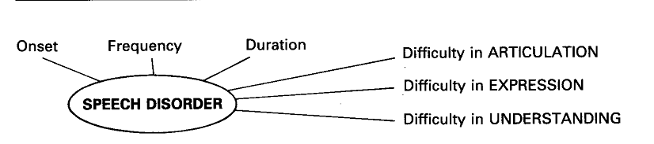
Speech disorder

Slide 11
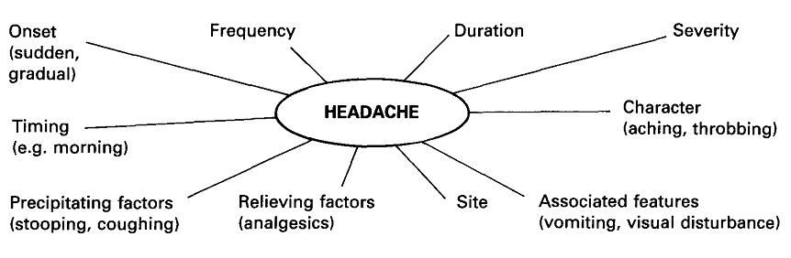
Headache

Slide 12
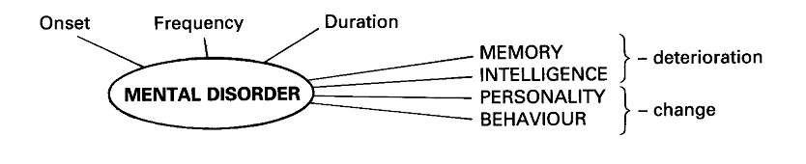
Mental disorder

Slide 13
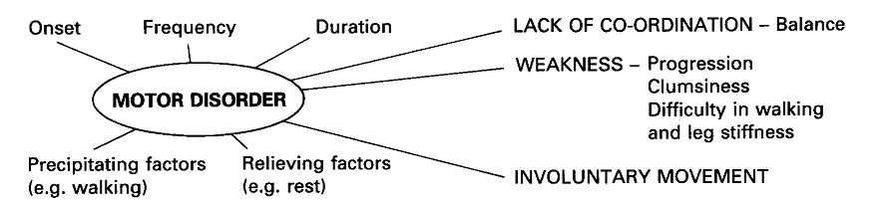
Motor disorder

Slide 14
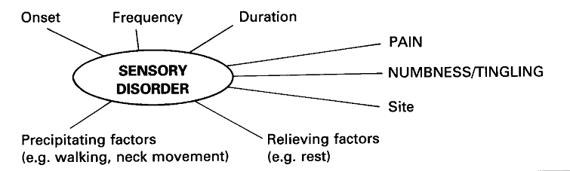
Sensory disorder

Slide 15
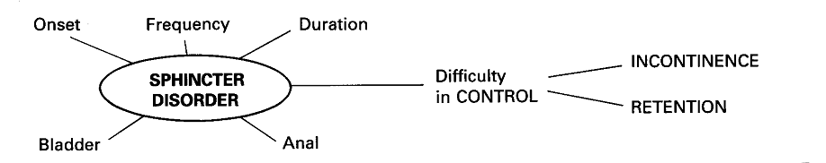
Sphincter disorder

Slide 16
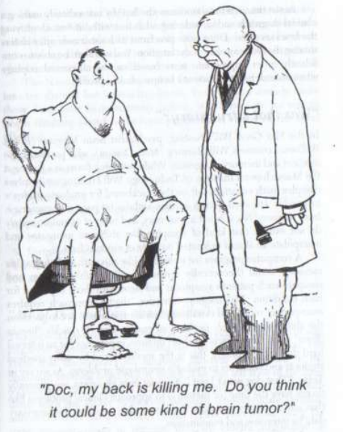
Even, if your patient is a professor of Medicine!

Slide 17
EXAMINATION IN NEUROLOGY
C_= Consciousness/Cognition
---------------------meninges
N = cranial Nerves
M = Motor system
S = Sensory sysyem
C = Coordination (cerebellum)
G = Gait

Slide 18
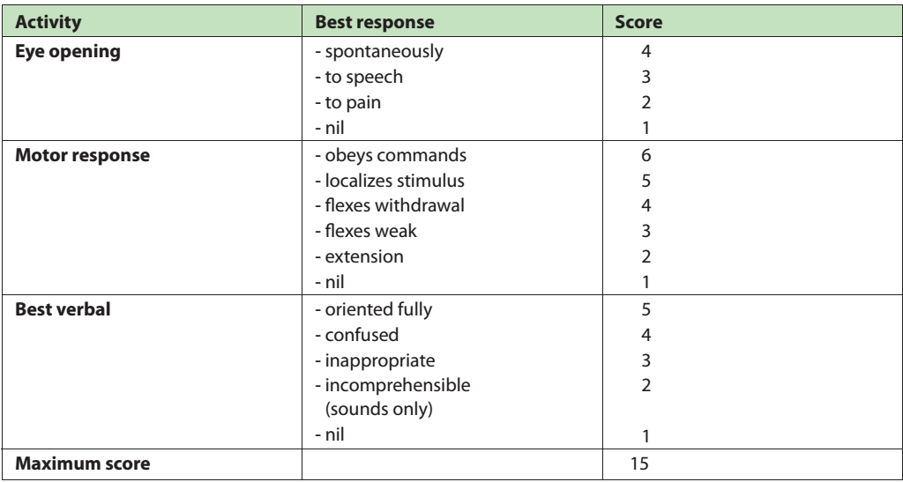
Glasgow coma scale

Slide 19
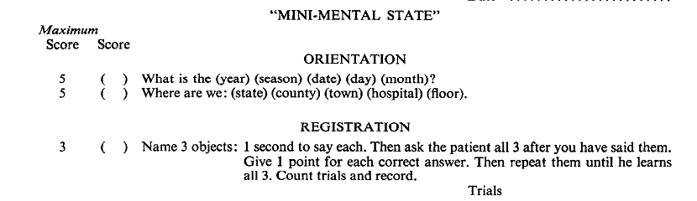
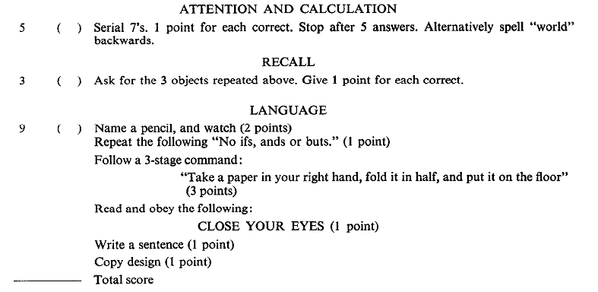
Mini-mental state examination

Slide 20
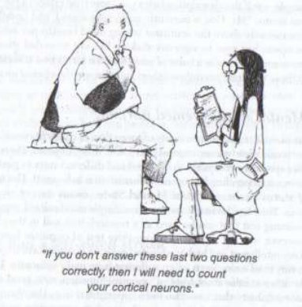
MMSE, done in clear consciousness/Dementia

Slide 21
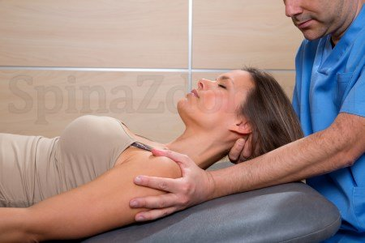
Meningeal irritation
Neck stiffness

Slide 22
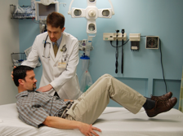
Meningeal irritation
Brudzinski’s sign

Slide 23
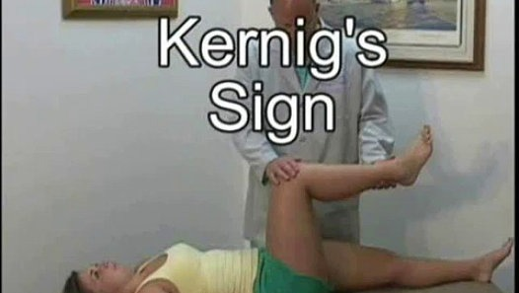
Meningeal irritation

Slide 24
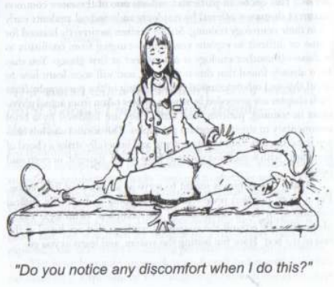
Student!!!

Slide 25
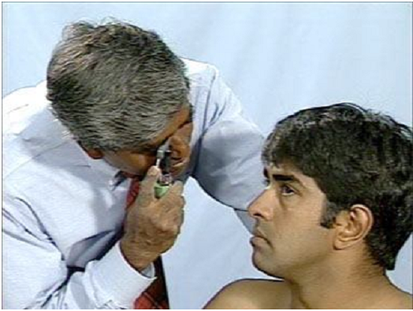
Fundoscopy

Slide 26
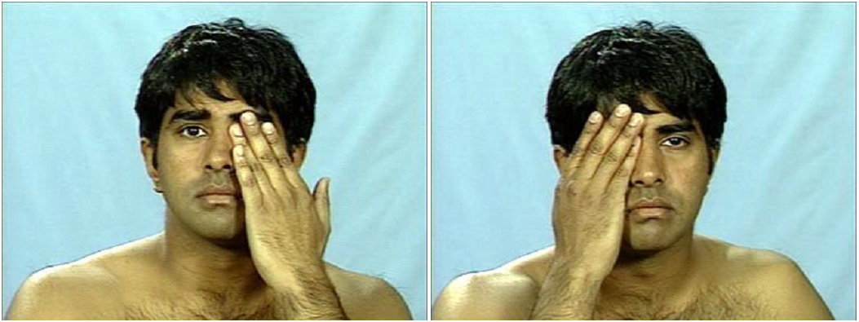
Visual acuity

Slide 27
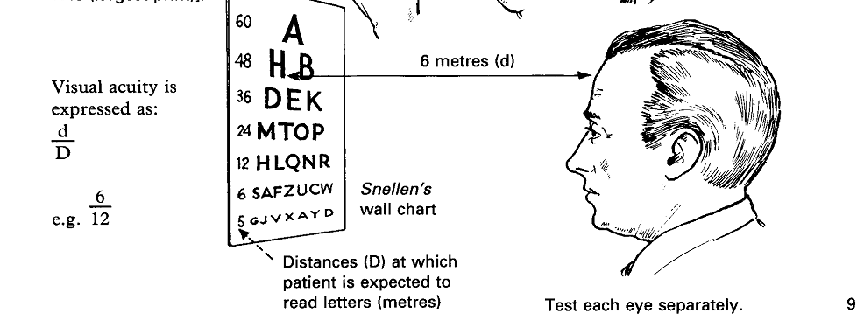
Visual acuity

Slide 28
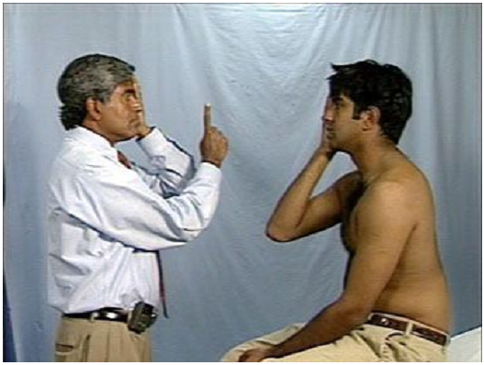
Visual field

Slide 29
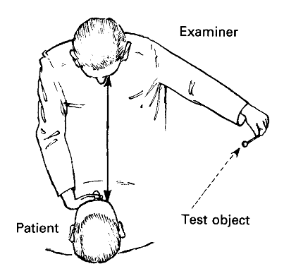
Visual field testing

Slide 30
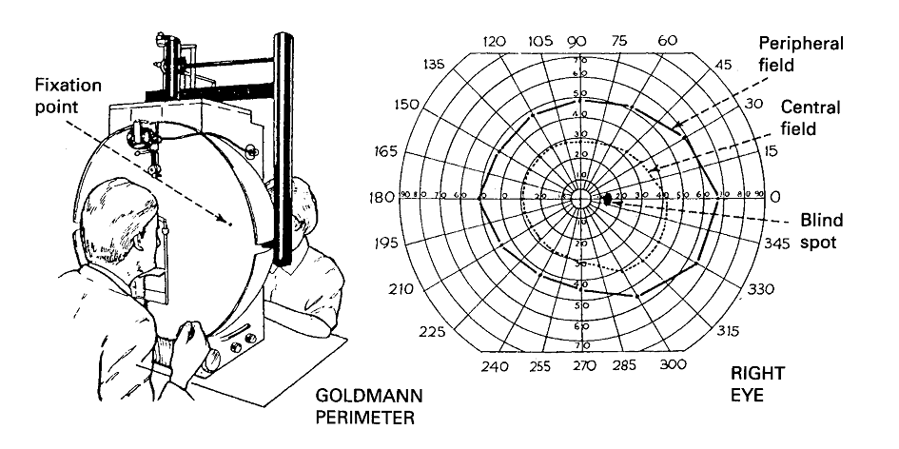
Goldman perimeter

Slide 31
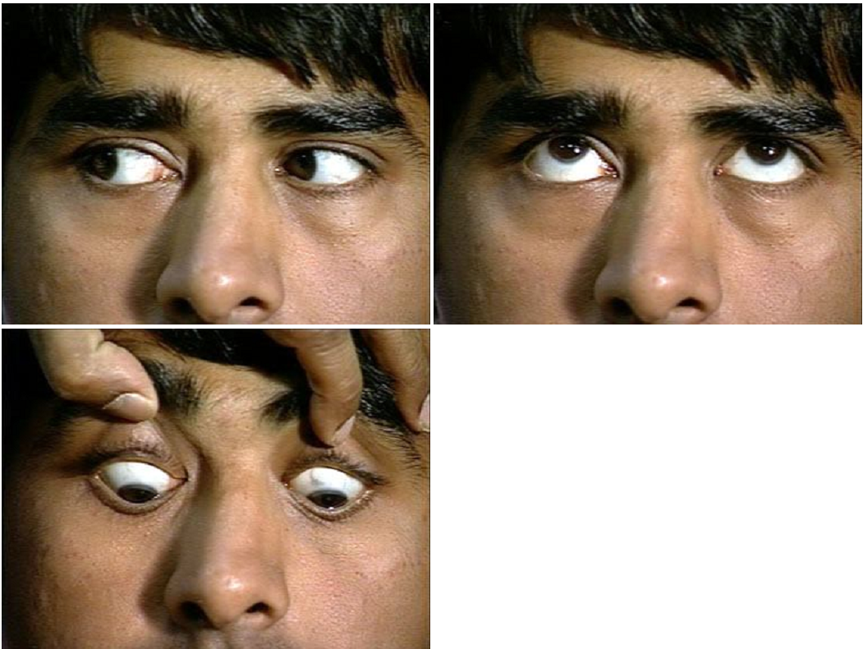
Extraocular muscles

Slide 32
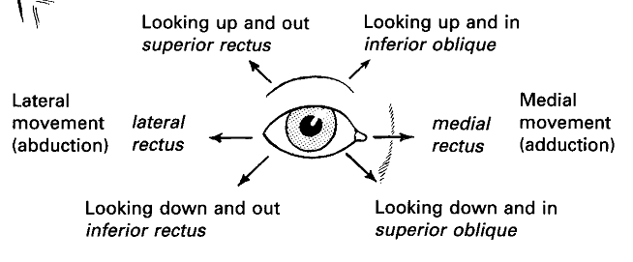
Extraocular muscles

Slide 33
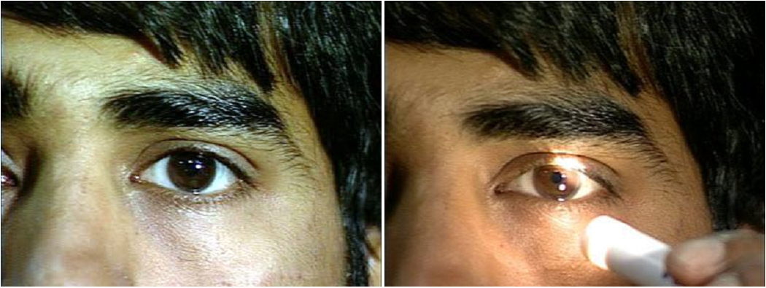
Pupillary eye reflex

Slide 34
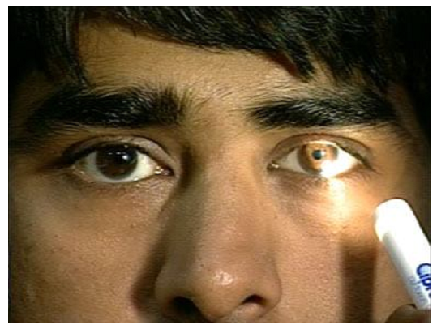
Pupillary eye reflex

Slide 35
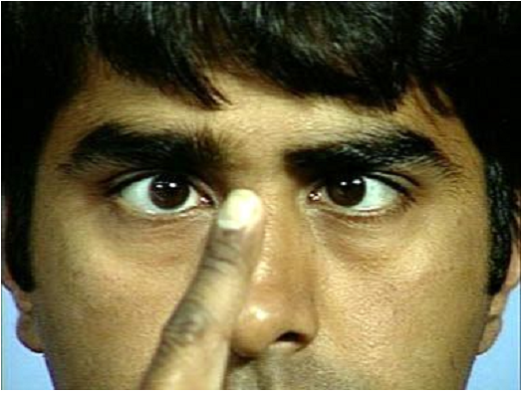
Accommodation

Slide 36
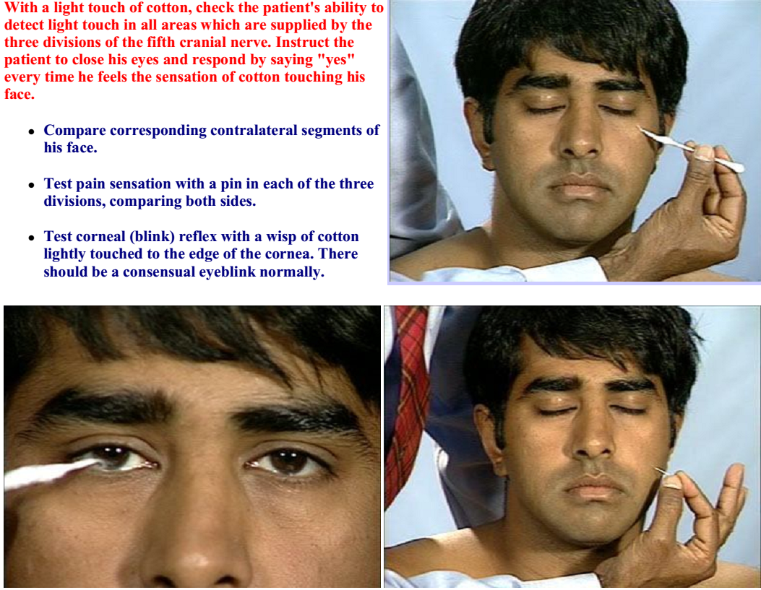

Slide 37
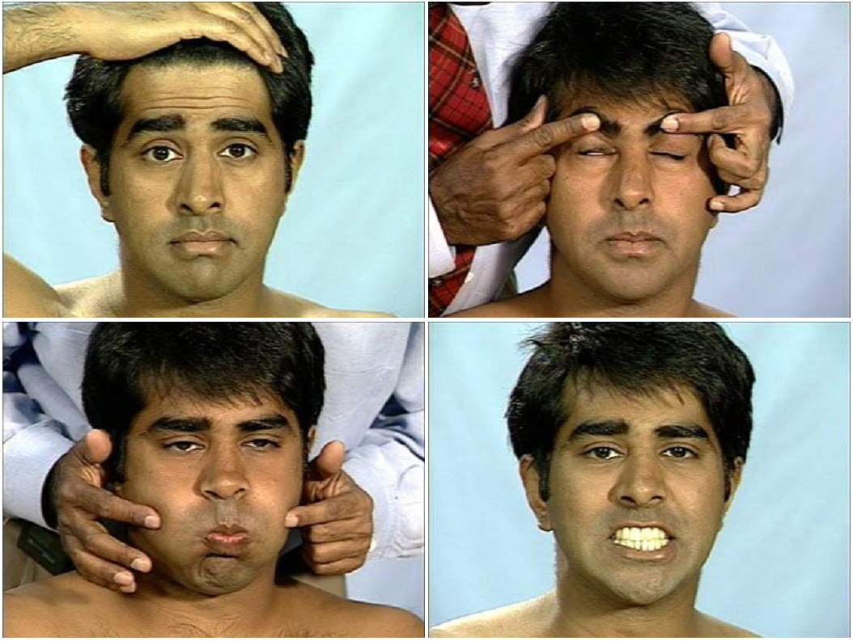
Facial nerve

Slide 38
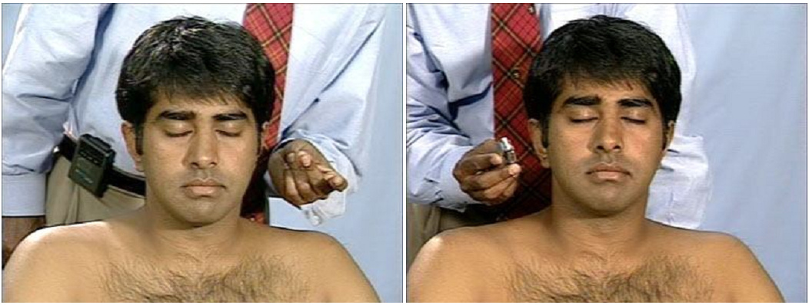
Vestibulocochlear nerve

Slide 39
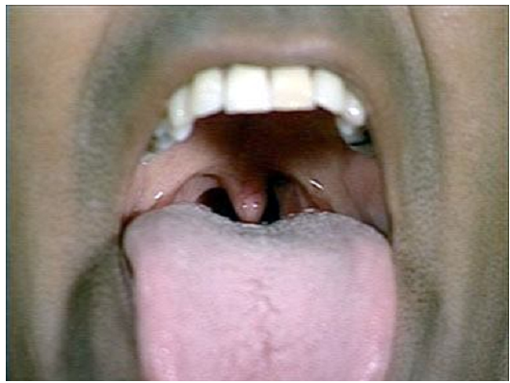
Vagus nerve

Slide 40
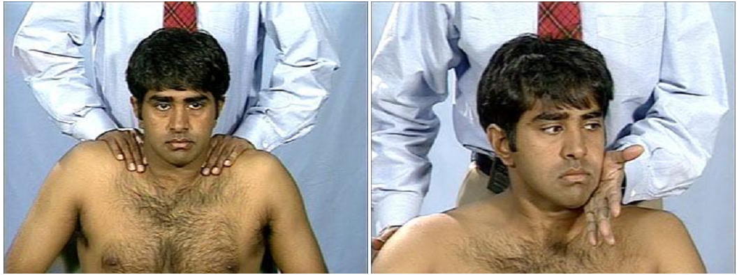
Assessory nerve

Slide 41
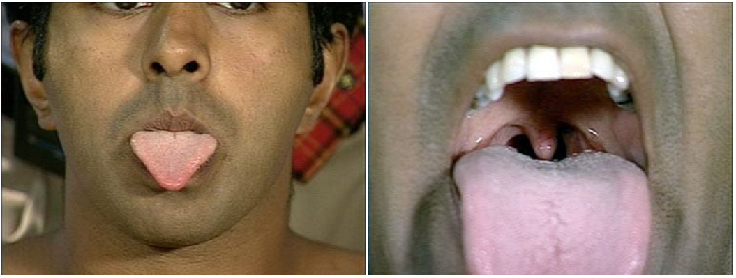
Hypoglossal nerve

Slide 42
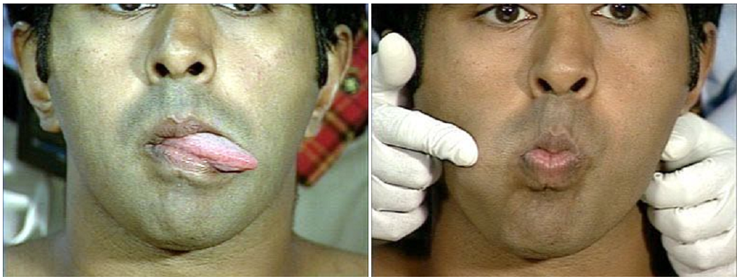
Hypoglossal nerve

Slide 43
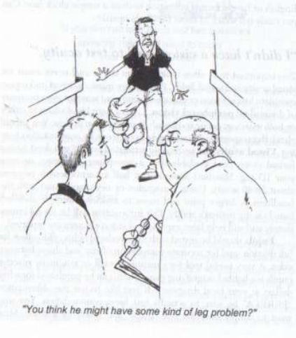
Some symptoms are quite obvious

Slide 44
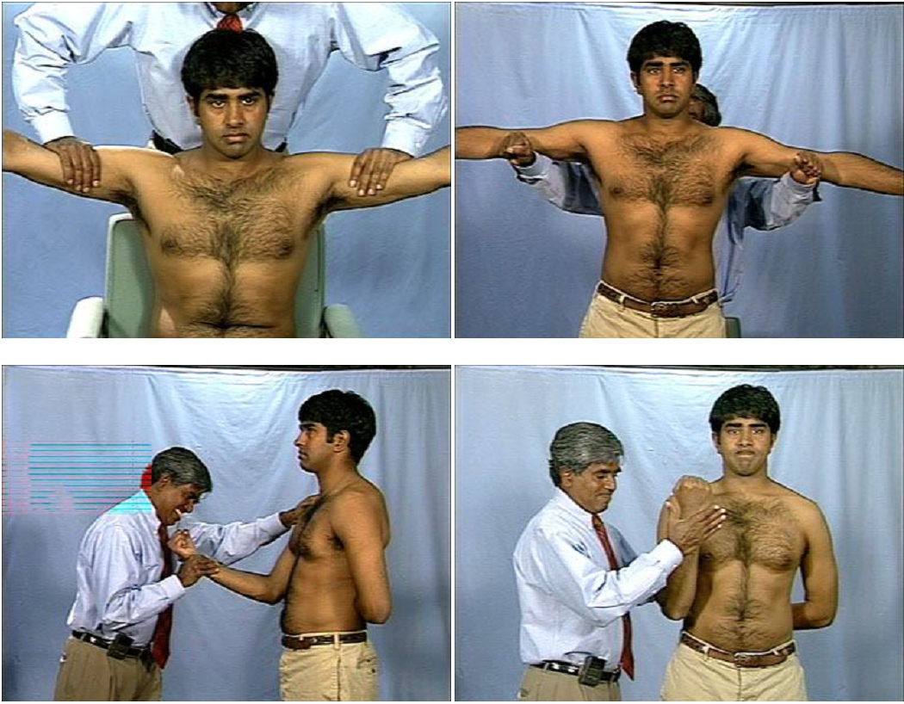
Upper limb muscles

Slide 45
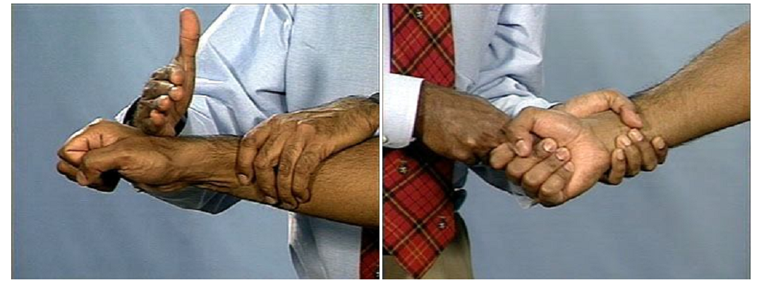
Extensors and flexors of the wrist

Slide 46
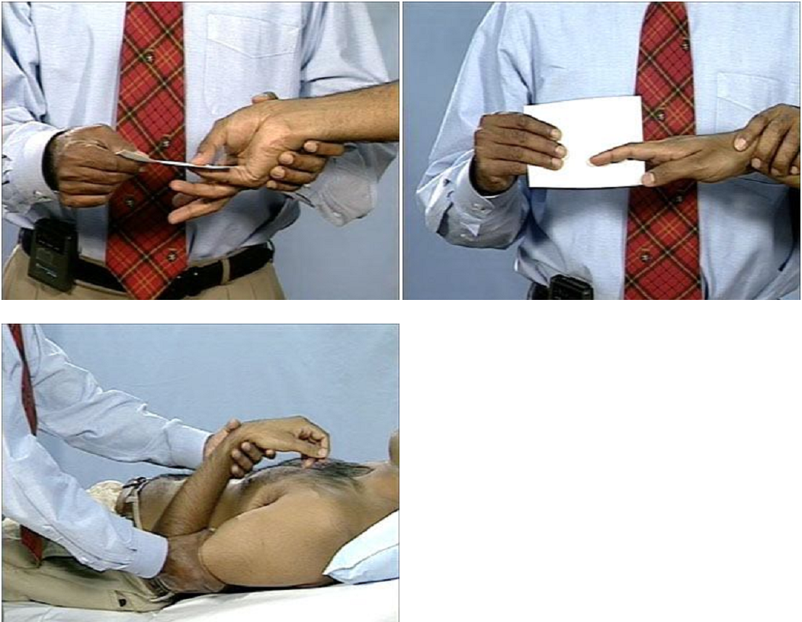
Small muscles of the hand

Slide 47
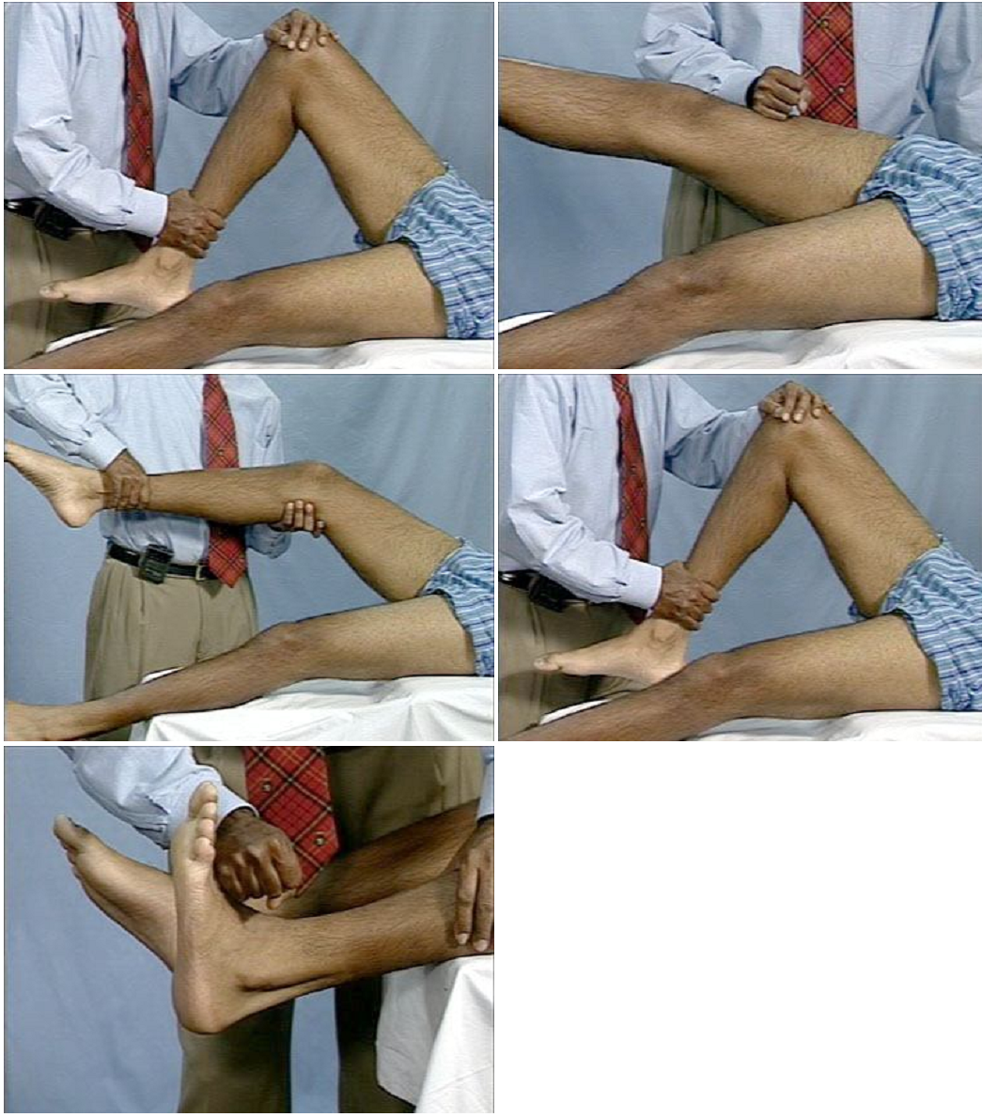

Slide 48
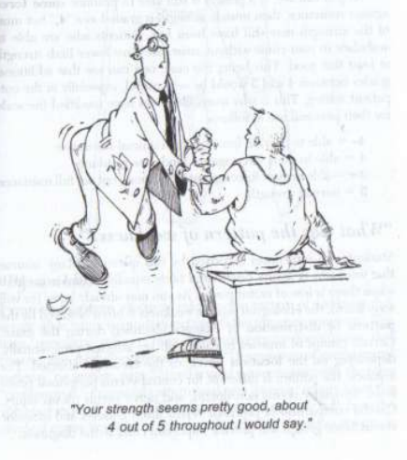
Students!!!

Slide 49
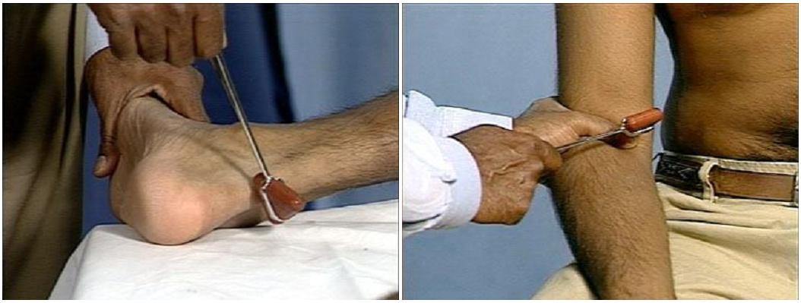
Deep tendon reflexes

Slide 50
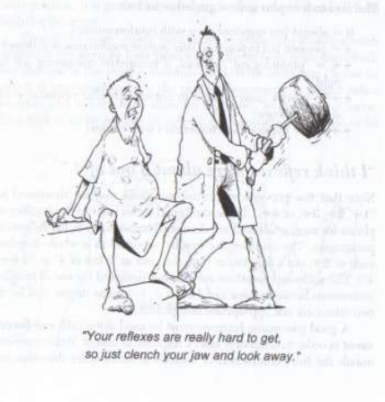
Students!!!

Slide 51
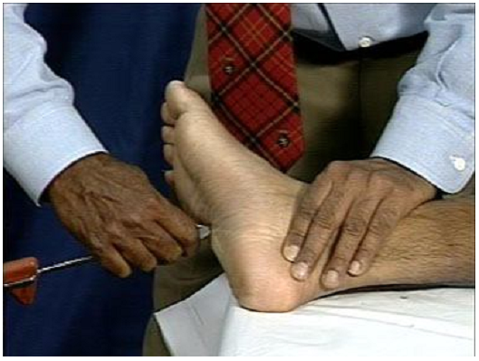
Plantal reflex

Slide 52
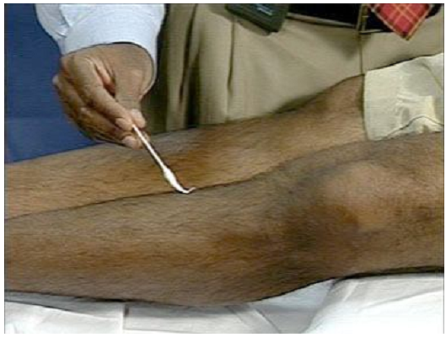
Light touch

Slide 53
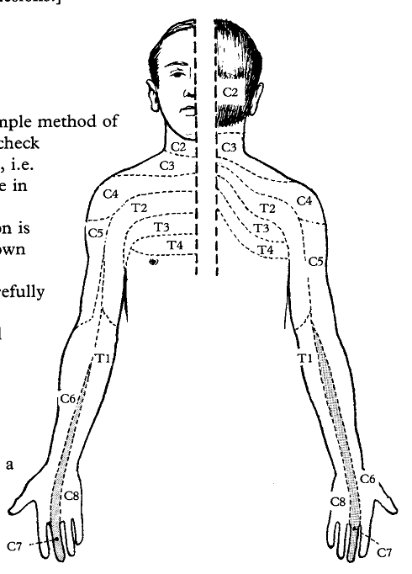
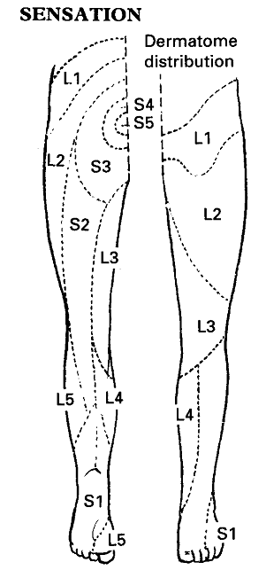

Sensation [dermatomes]

Slide 54

Joint position sense

Slide 55

Finger-nose test

Slide 56

A test of posterior column tracts

Slide 57

Gait

Slide 58
INVESTIGATIONS IN NEUROLOGY
GENERAL:
FBC + Differentials
ESR
Fasting lipid profile
Fasting blood sugar
E,U+Cr
Urinalysis
PT/INR
aPTT

Slide 59
INVESTIGATIONS IN NEUROLOGY
SPECIFIC:
NEUROIMAGING/ nuclear medicine: CT/ MRI, fMRI, Magnetic Resonance Tractography, Magnetic Resonance Spectroscopy PET scan, SPECT
Plain films/ x-rays
Carotid doppler USS
Catheter angiography
Myelography

Slide 60
INVESTIGATIONS IN NEUROLOGY
ELECTROPHYSIOLOGY: EEG, EMG/nerve conduction studies, evoked potentials
LUMBAR PUNCTURE

Slide 61

NORMAL EEG IN AN AWAKE INDIVIDUAL

Slide 62

NERVE CONDUCTION STUDY

Slide 63

NEEDLE ELECTROMYOGRAPHY
A NORMAL MUSCLE SHOULD BE SILENT AT REST

Slide 64

3D CT ANGIOGRAPHY

Slide 65

CERVICAL SPONDYLOSIS

Slide 66



STROKE
ISCHAEMIC
SUBARACHNOID HAEMORRHAGE
INTRACEREBRAL

Slide 67

CEREBRAL ABCESS
CT
MRI

Slide 68

QUESTIONS ? ? ?

Slide 69


